Slide 1
NoC Performance Analysis Tool with Hybrid Arbitration

Slide 2
Agenda
Introduce to Dot file
Functionality of the Tool.
Demonstration

Slide 3
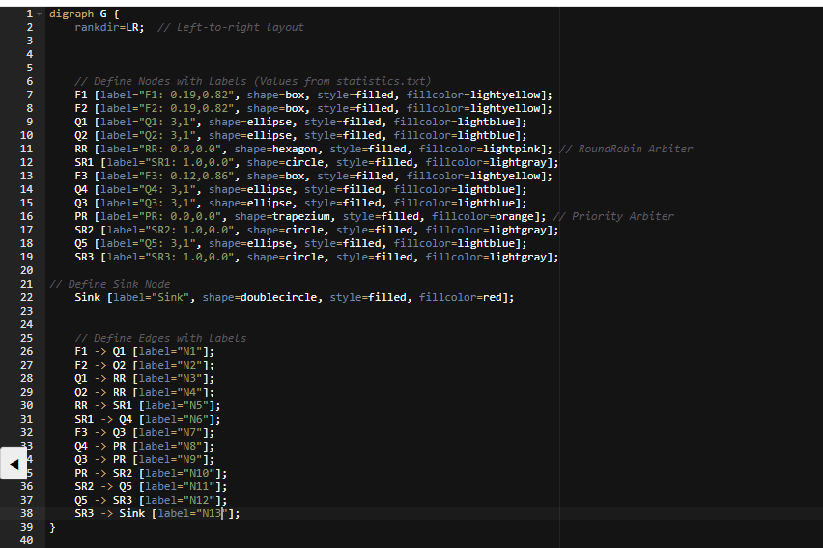
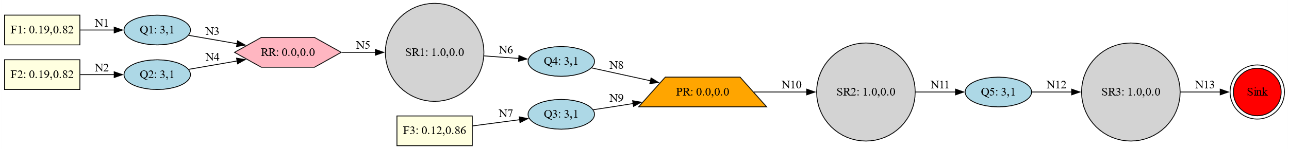
Introduce to .DoT file
Statistics.txt
Network.txt
F1=0.19,0.82
F2=0.19,0.82
F3=0.12,0.86
Q1=3,1
Q2=3,1
Q3=3,1
Q4=3,1
Q5=3,1
SR1=1.0,0.0
SR2=1.0,0.0
SR3=1.0,0.0
RR=0.0,0.0
PR=0.0,0.0
N1:F1,Q1
N2:F2,Q2
N3:Q1,RR
N4:Q2,RR
N5:RR,SR1
N6:SR1,Q3
N7:F3,Q4
N8:Q4,PR
N9:Q3,PR
N10:PR,SR2
N11:SR2,Q5
N12:Q5,SR3
N13:SR3,Sink
https://is.gd/RQ8FfD

Slide 4

























How this Tool is Working ?
Forward Move
$T_{1}^{′}$ +$∆T_{1}^{′′}=1.09408$
$$W_{1}=0.0787$$
$$W_{1}=0.06624$$
Q1
N3
RR1
N1
$T_{2}^{′}$ +$∆T_{2}^{′′}=1.21132$
$$λ_{1}=0.19$$
F1
$$W_{4}=0.21602$$
$$λ_{1}^{′}=0.189958$$
$$W_{4}=0.259092$$
$$λ_{4}^{′}=0.375588$$
$$λ_{4}=0.38$$
Q2
SR1
Q4
PR1
$$T_{2}=1.0$$
F2
N5
N6
N8
SR2
SR3
$$λ_{1}=0.19$$
N10
N11
N12
N13
$$λ_{2}^{′}=0.189958$$
N2
N4
$T_{1}^{′}$ = 1.05206
Sink
$$W_{2}=0.06624$$
$$T_{2}=1.0$$
$$W_{2}=0.0787$$
Q5
$T_{1}^{′}$ +$∆T_{1}^{ ′}=1.09408$
F3
$$λ_{5}=0.5$$
N7
Q3
N9
$$T_{2}^{′}=1.04043$$
$$W_{5}=0.0$$
$$λ_{3}=0.12$$
$$λ_{3}=0.12$$
$$λ_{3}^{′}=0.119998$$
$$λ_{3}^{′}=0.119998$$
$$W_{3}=0.0$$
$T_{2}^{′}$ +$∆T_{2}^{′ }=1.04043$
Backward Move

Slide 5
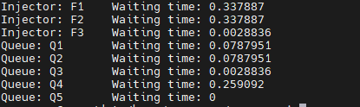

Demo 1: Hybrid arbitration
$$Q_{4}> Q_{3}$$

